Slide 1
Doing Excellent Software Development

Slide 2
What language to use?
Language is not important but rather how you use it

Slide 3
What is good software?
Better quality
Less overhead
Faster development
Happy customers
Happy developers

Slide 4
Agile
Agile tends to work in this direction but its early adapters are slowly moving away from it
It is however still in widespread use

Slide 5
14th Annual State of Agile Report
Released in 2019
About 40,000 people participated in the state of agile survey

Slide 6
Findings
Organizational culture is still at odds with Agile methodologies
Scrum is the most widely practiced Agile method/ framework, with at least 75% of respondents practicing Scrum
Ability to manage changing priorities and project visibility are the top 2 capabilities reported as having improved as a result of Agile implementation.

Slide 7
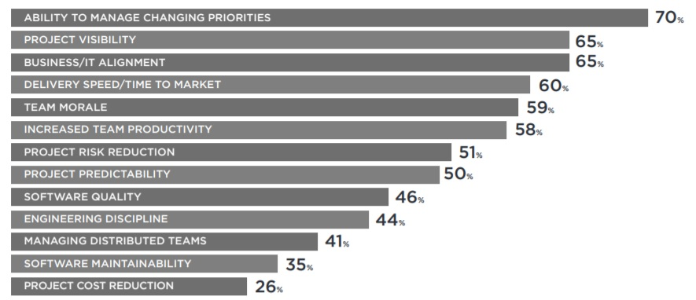
Agile Benefits

Slide 8
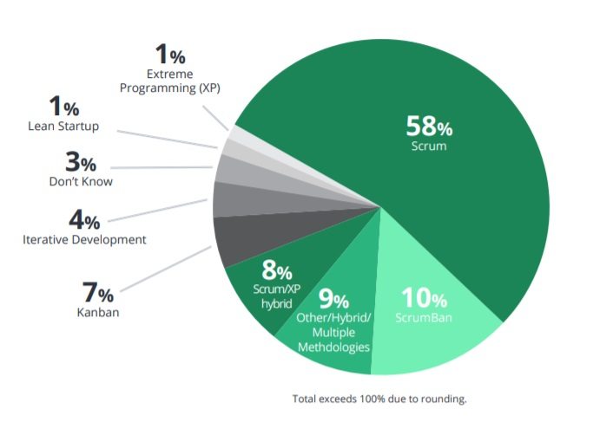
Agile Methods and Practices

Slide 9
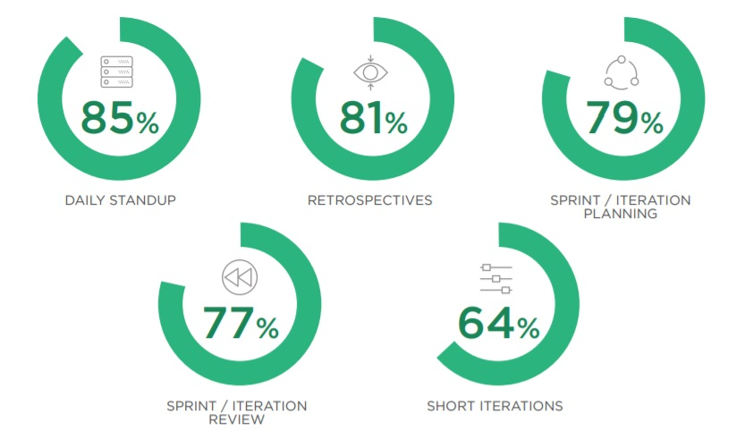
Top 5 Agile Techniques

Slide 10

Agile Management Tools in Use

Slide 11
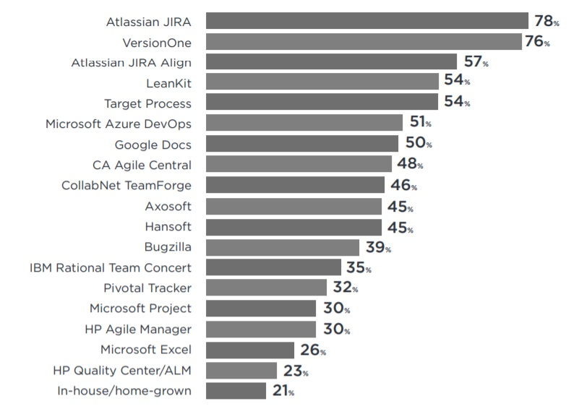
Recommended Project Management Tools

Slide 12
Introspection
Teams are looking towards introspection rather than a methodology to fix their problems
You know your team best, so you know where the problem lies

Slide 13
Compiles? == Ship it
Minimize time between development and delivery

Slide 14
Four Keys to Great Software Development
Build great things
Have a great team
Have Excellent collaboration
Increase Automation

Slide 15
Build great things
Fake it till you make it
Get ideas to the customer as quickly as you can

Slide 16
Speech to text experiment
Works for small bursts
User do not spend hours doing it
Novelty wears of quickly
Cannot work in a public environment

Slide 17
Make prototypes
Paper prototypes is where you should begin
Low cost
Less attachment

Slide 18

Generating Great Feedback Experience

Slide 19
Generating Great Feedback Experience
Super simple
Easy to find
Fast to submit

Slide 20
Generating Great Feedback Experience
Protect your developers
Do not let them worry about feedback
But put them on support from time to time so they understand clients better

Slide 21
Building a Great Team
Great developers that can test each other’s work
You will require QA testers as well
Quality is everybody’s responsibility
Department barriers slow you down, work as a team

Slide 22
Excellent Collaboration
You can’t be a lone coder if you work in a team
Follow rules like code conventions
Rules help in avoiding mistakes

Slide 23
Excellent Collaboration
Branch for every task
branch
pull
merge

Slide 24
Where do you work best?
Allow them to work where they are most productive
It is even more important these days!

Slide 25
Use tools wisely
Discord?
Teams?
Slack?

Slide 26
Automation
Automate as much as you can

Slide 27
Testing
Parallelize your tests
Platform tests
Performance tests
Unit & UI tests

